Slide 1

FINAL PRESENTATION

Slide 2

XENON COMPILER
MEXICO CITY

Slide 3
The compiler should read more complex operations in the "return":

Slide 4
Logical AND: &&
Logical OR: ||
Equal to: ==
Not Equal: ! =
Less than: <
Less or equal: <=
Greater than: >
Greater or Equal: > =

Slide 5
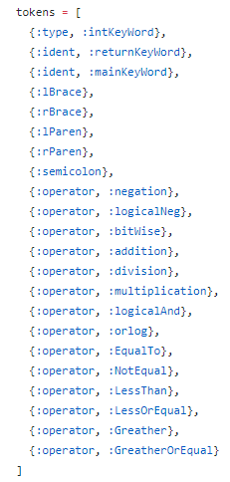
TOKENS

Slide 6

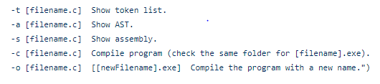
SWITCHES

Slide 7

For the following source code

Slide 8
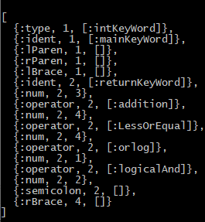
TOKEN LIST

Slide 9
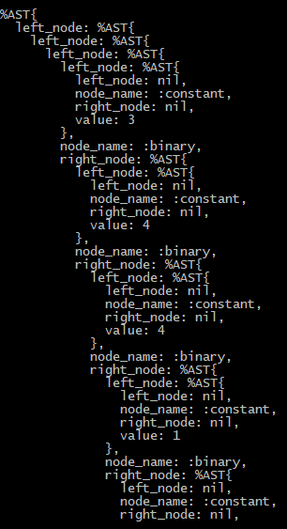
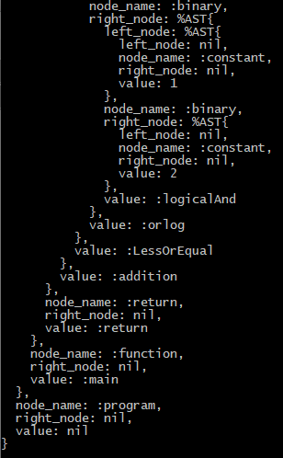
TREE

Slide 10
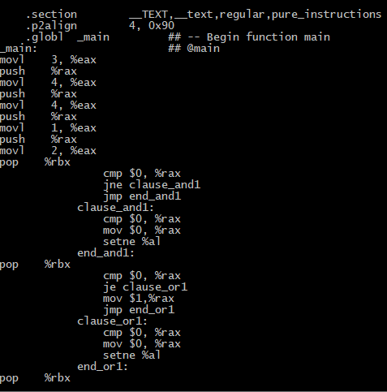
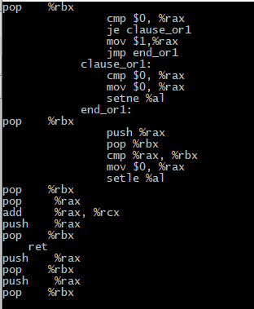
ASSEMBLY CODE

Slide 11
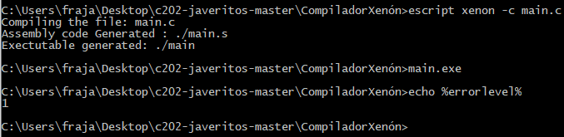
COMPILATION

Slide 12
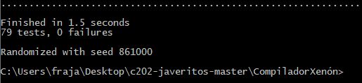
TEST

Slide 13
THANKS

